Slide 1
Data Recruitment Exercise
By William Cawley Gelling

Slide 2
Data Cleaning
This cleaning process can be run automatically on the main database by using the python document found at https://github.com/WilliamCawleyGelling/WilliamCawleyGelling/tree/main/Grayce
removing excess empty columns
Assumption made here was that these columns are not in use in the sample data or the main database.
The columns that are removed initially are TRANS_DATE, CUST_ALT_REGION, NOTES, CUST_NOTES, SPECIAL_REQUEST, DISCOUNT_C
When running this code, it searches for only empty columns, if not empty then it will not delete
NO_OF_ITEMS also deleted as its values are all 0 and its job is done by ITEM_VOLUME, ITEM_VOL
LOYALTY has a ‘y’ instead of ‘Y’ for transaction 4492, replace “y” with “Y”

Slide 3
Data Cleaning
Deleting rows that have the same value.
REGION, CUST_REGION, CUST_AREA have the same values, I have removed CUST_REGION, CUST_AREA.
This is automated and if the values are not the same they will not be deleted.
DELIVERY_DATE and MONTH have the same value so removed MONTH
Combining Columns where the database has changed
When the historical data was moved over ITEM_VOL moved to ITEM_VOLUME. These have been combined and ITEM_VOL removed.
Fill nan with 0
For Tax it makes more sense for the empty values to be 0.
Loyalty
Before the change of system everyone was given a LOYALTY_ID, after this date not everybody was. LOYALTY_ID doesn’t mean they have loyalty currently.
Originally they where float numbers and now they are integers.
This could be changed if knowledge of what people’s ID changed to is available. As this information was unavailable, I changed nothing.

Slide 4
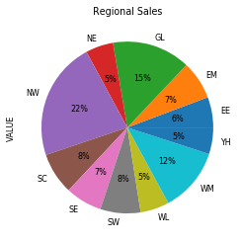
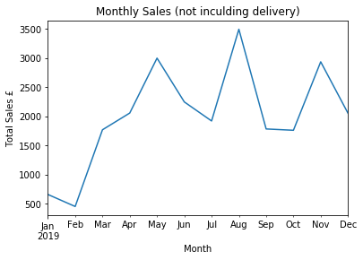
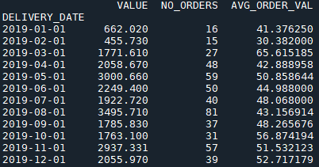
Analysis

Slide 5
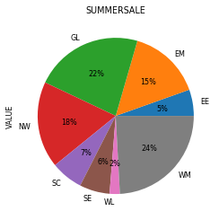
Number of sales using code.
During the spring clean sale in April and May, 107 sales were made 21 of these used the discount code SPRINGCLEAN 19.6%.
The advertisement showed an increase in sales not using the SPRINGCLEAN code as well compared to the earlier month. This could be due to two factors, the advertisement and the time of year.
During the summer sale in August 81 sales occurred with 30 using the code “SUMMERSALE” 37%. This shows a large increase in sales per month and also an increase in the effect of the concentrated advertisement.
This advertisement concentrated on areas with two of the largest cities, so the funding was distributed to a higher population per area.

Slide 6
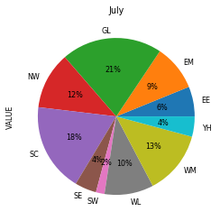
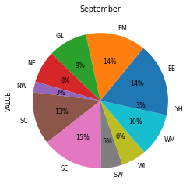

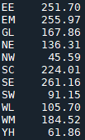
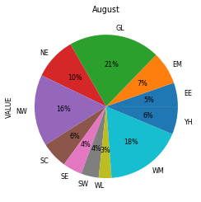
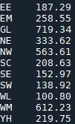
Effect of Sale period

Slide 7
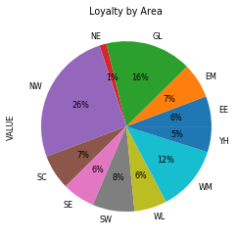
Loyalty Profit
Taken from the sample 226 out of the 500 transactions that happened occurred with customers who are loyal.
Of these transactions 169 of the 226 are with unique ID’s. This means 57 transactions were repeated purchases.
From this sample a £5 buy-in provides free delivery. The income from selling loyalty is £845.
The cost of losing delivery charges is £449.74, which means a profit of £385.26.
The average spend by a loyal customer was £51.19 and £45.95 for non-loyal customers.
In the pie chart you can see that loyalty is lowest in the Northeast and Yorkshire Humber.

Slide 8
Strategy for upcoming year
The worst months were January and February. Consider having a post-Christmas sale to increase January sales.
Moving advertisement to start in February could help with the lowest sales month.
Keep advertisement in august this worked well and increases the profile of the product just before the Christmas shopping period.
Consider using an advertising budget for the Summer sale in Yorkshire and Humber or the Northeast to increase presence and expand loyalty
Continuation of two sales starting in February and August sets them six months apart for the advertising budget to be equally distributed across the year.
Loyal customers spend on average £5.24 more. Worth pushing this scheme for increased profits and knowledge of customer trends
Consider storing user’s email used for purchase so you can compare loyal users’ purchases per year compared to non-loyal customers
Implement data cleaning methods database-wide.

